Slide 1

Geometry
Unit 2, Lesson 1 Introduction to Euclidean Geometry Volume 1, pg. 83

Slide 2


Benchmarks
MA.912.GR.1.1
Prove relationships and theorems about lines and angles. Solve mathematical and real-world problems involving postulates, relationships and theorems of lines and angles.
MA.912.LT.4.10
Judge the validity of arguments and give counterexamples to disprove statements.
volume 1, pg. 83

Slide 3
Integrated Mathematical Thinking and Reasoning Standards
MA.K12.MTR.1.1 Actively participate in effortful learning both individually and collectively.
MA.K12.MTR.2.1 Demonstrate understanding by representing problems in multiple ways.
MA.K12.MTR.4.1 Engage in discussions that reflect on the mathematical thinking of self and others.
MA.K12.MTR.5.1 Use patterns and structure to help understand and connect mathematical concepts.
MA.K12.MTR.7.1 Apply mathematics to real-world contexts.
volume 1, pg. 83

Slide 4

Learning Targets
I can distinguish between definition, postulate, and theorem.
I understand the role of proof.
I can relate properties of equality to the properties of congruence.
volume 1, pg. 83

Slide 5

Warm-Up
volume 1, pg. 83

Slide 6
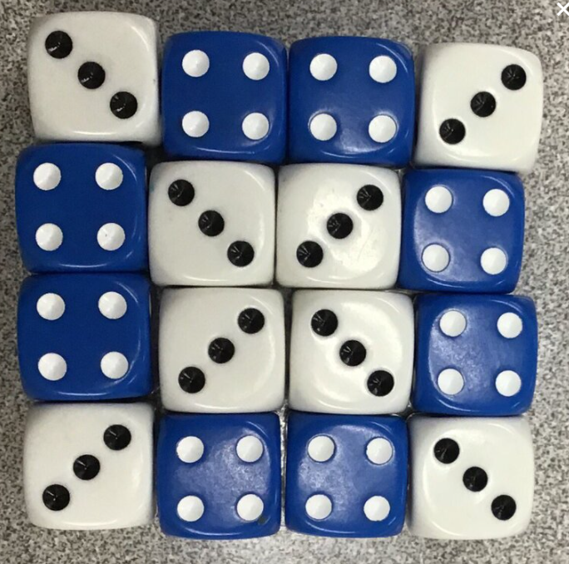
2.1.1 Warm-Up: Number Cubes Math
A picture of 16 number cubes is shown.
What do you notice?
Find the sum of the number cubes. Show your work or explain your thinking.
If all of the number cubes with 3 dots were changed to number cubes with 6 dots, how would you find the new sum? Show your work or explain your thinking.
volume 1, pg. 83

Slide 7

Exploration
volume 1, pg. 84

Slide 8


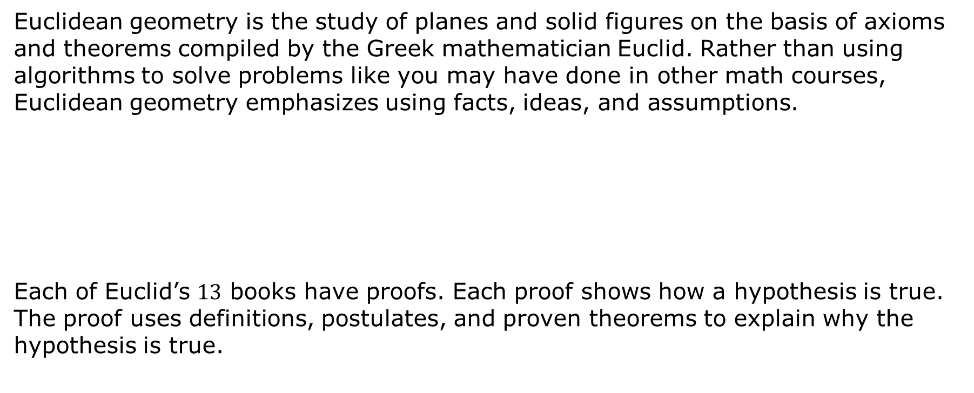
2.1.1 Exploration: What is Euclidean Geometry?
Euclidean geometry is the study of planes and solid figures on the basis of axioms and theorems compiled by the Greek mathematician Euclid. Rather than using algorithms to solve problems like you may have done in other math courses, Euclidean geometry emphasizes using facts, ideas, and assumptions.
Each of Euclid’s $13$ books have proofs. Each proof shows how a hypothesis is true. The proof uses definitions, postulates, and proven theorems to explain why the hypothesis is true.
Euclid is known as the father of Geometry. He wrote 13 books using an axiomatic system to construct bodies of knowledge.
volume 1, pg. 84

Slide 9


A postulate is an idea that is assumed to be true or something that is self-evident.
The first postulate in Euclid’s Book 1 is shown.
A straight line segment can be drawn joining any two points.
Use a straightedge to show the postulate using the points shown.
Discuss with your partner why a postulate is something that is self-evident. Summarize your discussion.
$$W$$
$$R$$
A theorem is an idea that has to be shown to be true through a chain of reasoning, often called a proof.
volume 1, pg. 84

Slide 10

Vertical Angles Theorem: If two lines intersect, then vertical angles are congruent.
The vertical angles are
and
,
and
volume 1, pg. 85

Slide 11
A pictorial proof of the vertical angles theorem is shown.
Therefore,
In the same manner,
+
=
+
=
=
=
volume 1, pg. 85

Slide 12
Discuss with your partner the pictorial proof of the vertical angles theorem below. Complete the description for each picture shown in the pictorial proof.
Picture | Description
 | The yellow angle and the red angle are being added.
+
+
volume 1, pg. 85

Slide 13
=
=
Proofs play an important role in the course of geometry. Proofs can take on many forms. They are the set of logical steps that explain why something is true.
When programmers write a new game, they use a set of logical steps. When you tie your shoes, you use a set of logical steps.
volume 1, pg. 85

Slide 14
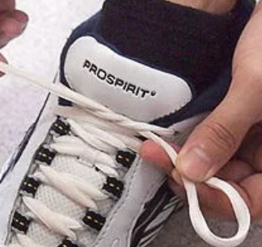
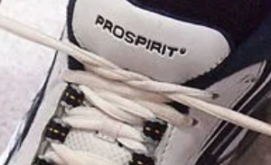
Work with your partner to place the steps in tying a pair of shoes in order.
Step | Description | Picture
 | Make a loop in one lace.
 | Cross the laces and pull them tight.
volume 1, pg. 86

Slide 15
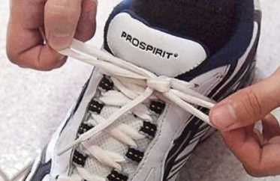
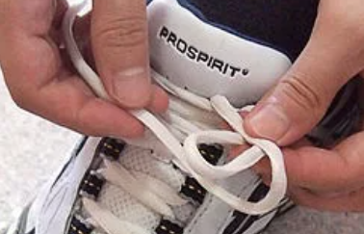
Step | Description | Picture
 | Pull both loops tight.
 | Wrap the other lace around the loop and push some lace through the hole that is made at the bottom to make a second loop.
Discuss with your partner why someone who learned to tie their shoes using a different method may have difficulty putting these steps in a logical order. Summarize your discussion.
volume 1, pg. 86

Slide 16

Guided Instruction
volume 1, pg. 86

Slide 17
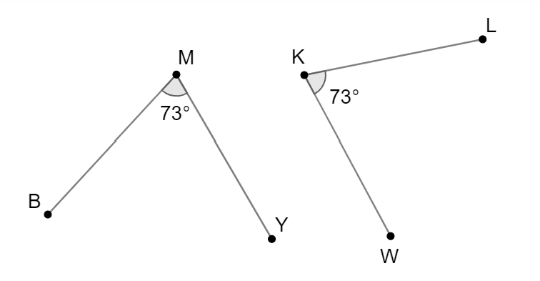
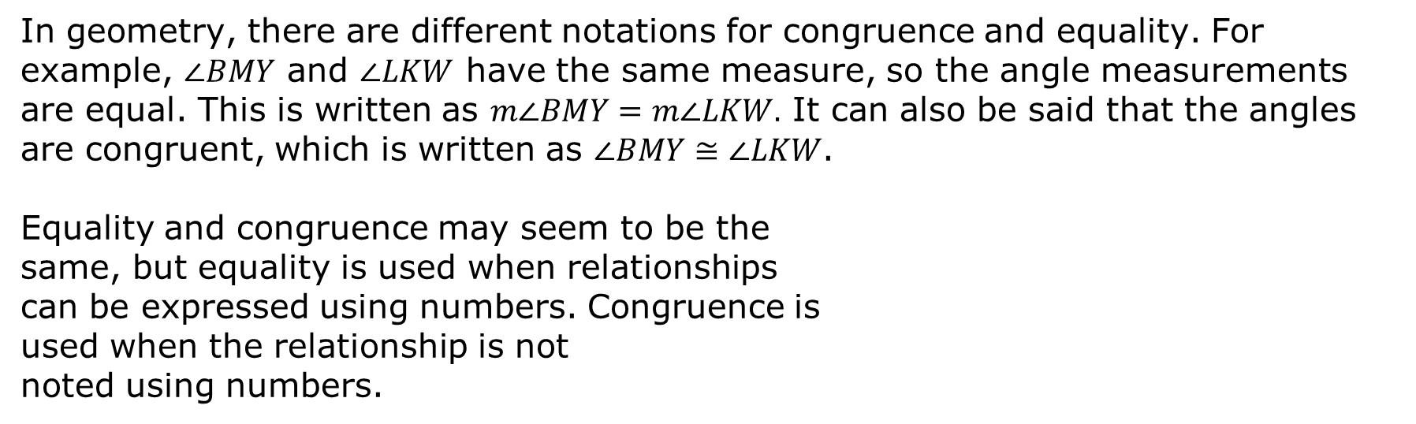
2.1.3 Guided Instruction: Properties of Equality and Congruence
In geometry, there are different notations for congruence and equality. For example, $∠BMY$ and $∠LKW$ have the same measure, so the angle measurements are equal. This is written as $m∠BMY=m∠LKW.$ It can also be said that the angles are congruent, which is written as $∠BMY≅∠LKW$.
Equality and congruence may seem to be the
same, but equality is used when relationships
can be expressed using numbers. Congruence is
used when the relationship is not
noted using numbers.
volume 1, pg. 86

Slide 18
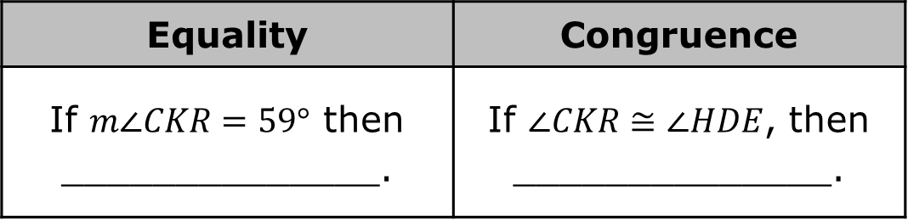
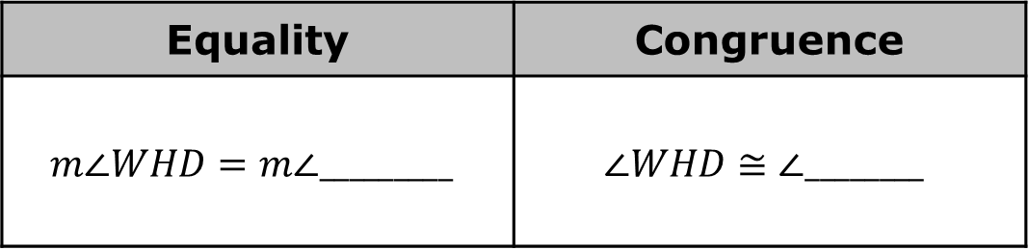
For each property, complete the example(s).
Reflexive property
Symmetric property
Equality | Congruence
$$m∠WHD=m∠_________$$ | $$∠WHD≅∠________$$
Equality | Congruence
If $m∠CKR=59°$ then ______________. | If $∠CKR≅∠HDE$, then ______________.
volume 1, pg. 87

Slide 19
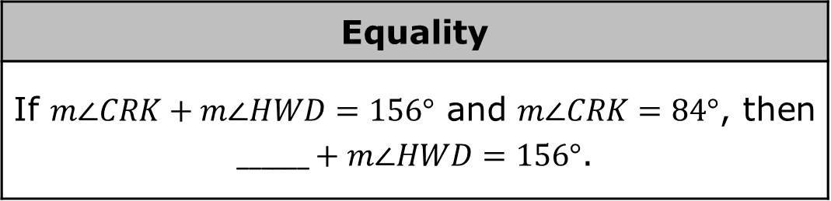
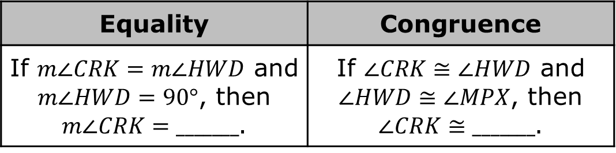
Transitive property
Substitution property
Equality | Congruence
If $m∠CRK=m∠HWD$ and $m∠HWD=90°$, then $m∠CRK=_______$. | If $∠CRK≅∠HWD$ and $∠HWD≅∠MPX$, then $∠CRK≅_______$.
Equality
If $m∠CRK+m∠HWD=156°$ and $m∠CRK=84°$, then $______+m∠HWD=156°$.
volume 1, pg. 87

Slide 20
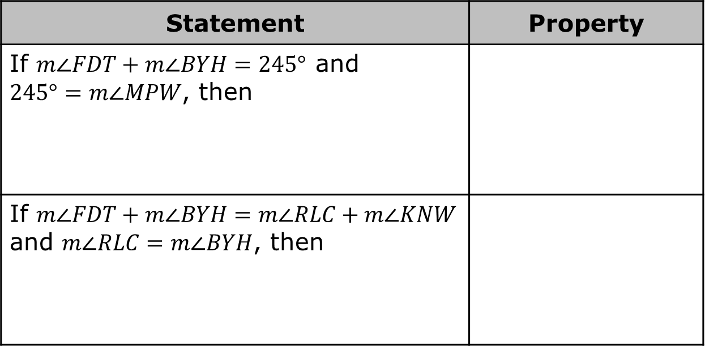

Write the conclusion for each statement. Then, name the property.
Discuss with your partner the conditional statement, “If $m∠CRK=m∠HWD$, then $∠CRK≅∠HWD$.” Summarize your discussion.
Statement | Property
If $m∠FDT+m∠BYH=245°$ and $245°=m∠MPW$, then
If $m∠FDT+m∠BYH=m∠RLC+m∠KNW$ and $m∠RLC=m∠BYH$, then
volume 1, pg. 87

Slide 21

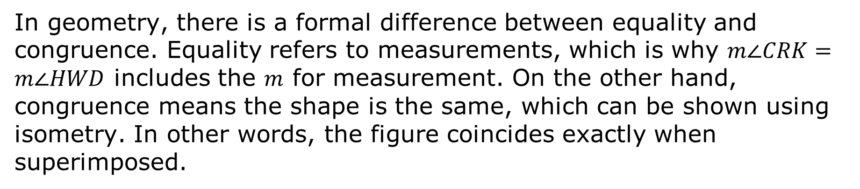
In geometry, there is a formal difference between equality and congruence. Equality refers to measurements, which is why $m∠CRK=m∠HWD$ includes the $m$ for measurement. On the other hand, congruence means the shape is the same, which can be shown using isometry. In other words, the figure coincides exactly when superimposed.
If two figures have equal measurements, then by the definition of congruence the figures are congruent. If congruence is shown through a series of transformations, then the definition of congruence in terms of rigid motions was applied.
volume 1, pg. 87

Slide 22
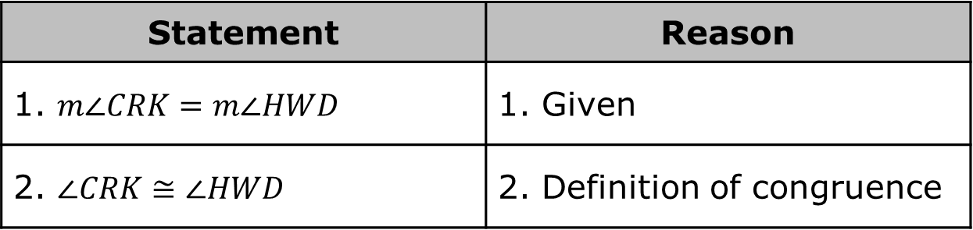
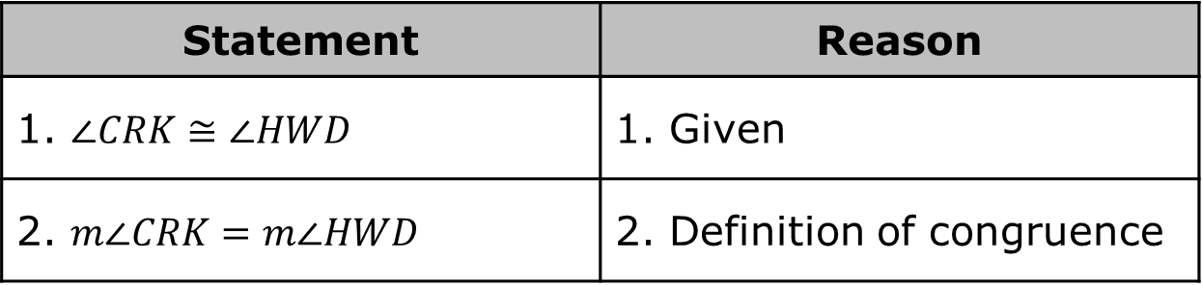
The definition of congruence can be used to change from congruence to equality.
Or, the definition of congruence can be used to change from equality to congruence.
Statement | Reason
1. $∠CRK≅∠HWD$ | 1. Given
2. $m∠CRK=m∠HWD$ | 2. Definition of congruence
Statement | Reason
1. $m∠CRK=m∠HWD$ | 1. Given
2. $∠CRK≅∠HWD$ | 2. Definition of congruence
volume 1, pg. 88

Slide 23

Gottfried Wilhelm Leibniz (1646-1716) introduced a symbol using one horizontal bar under the tilde for congruence in an unpublished manuscript of 1679. In 1824, Carl Brandan Mollweide (1774-1825) used the modern congruent symbol with two horizontal bars under a tilde in the book, Euklid's Elemente.
volume 1, pg. 88

Slide 24

Wrap-Up
volume 1, pg. 88

Slide 25
2.1.4 Wrap-Up: Cool Down
Complete the table.
The terms and information used in the Exploration and Guided Instruction that I knew were… | Something I wondered during the Exploration or Guided Instruction was… | Something I learned during the Exploration or Guided Instruction was…
volume 1, pg. 88

